Slide 1
In-depth Spectrum analysis
August 2024
Andrea Corrado

Slide 2
Outline
Why delve into spectral analysis
Expectations on EG spectrum
Processing pipeline to estimate spectrum
Filtering strategy
Spectrum estimation strategy
Results on external data
Conclusions

Slide 3
Outline
Why delve into spectral analysis
Expectations on EG spectrum
Processing pipeline to estimate spectrum
Filtering strategy
Spectrum estimation strategy
Results on external data
Conclusions

Slide 4
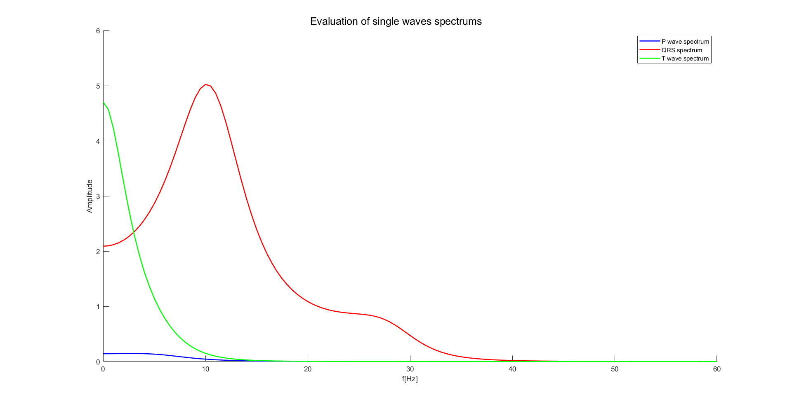
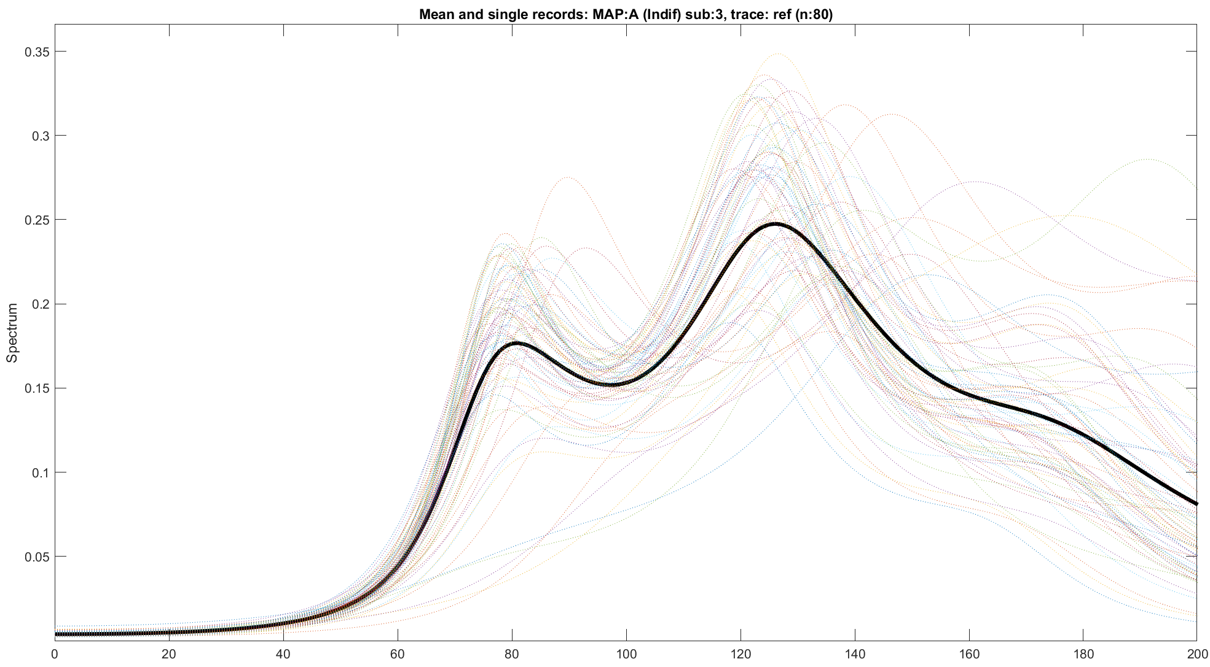
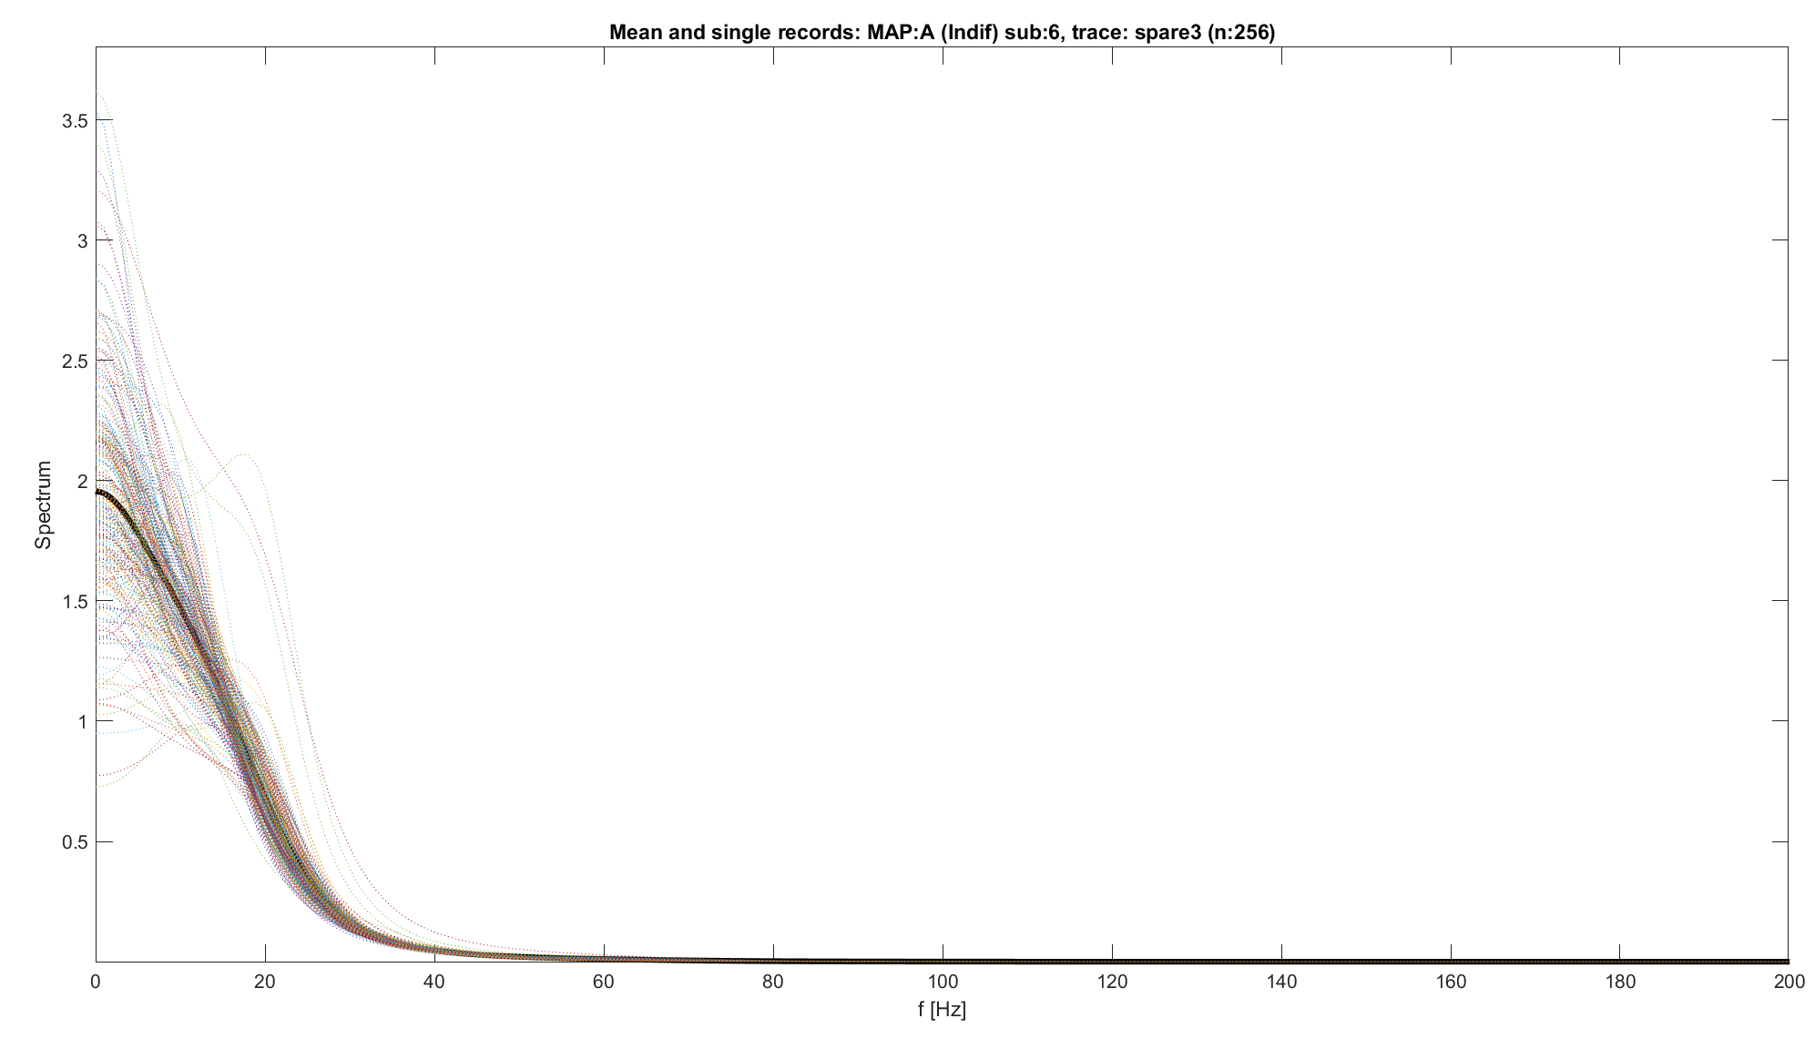
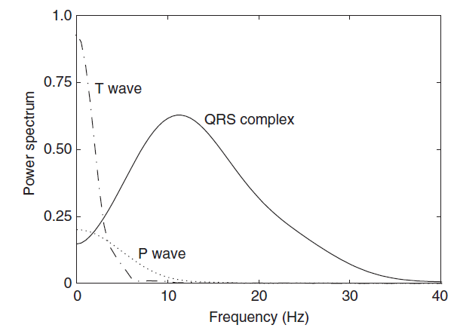
Why delve into spectral analysis
Previously, we found reference traces with unclear behaviours:
Absence of low-frequency components
Huge presence of high frequency components
Or:
Frequency components totally squeezed into low frequences, without any peak
Are these characteristics acceptable? Which is the expected shape of a spectrum of an ECG signal? [1]
T wave localised before 10H, Highest peak
P wave localized before 15 Hz, possibly masked by other components
QRS between 1 and 40 Hz, with one or more peaks.
NB: reference figure can be used even with AR spectrum estimation. In this case, a single beat manually modified.
Spectrums evaluated so far are not acceptable
NB: Reference figure obtained using Welch Spectrum Estimation
Sörnmo, Leif, and Pablo Laguna. "Electrocardiogram (ECG) signal processing." (2006).

Slide 5
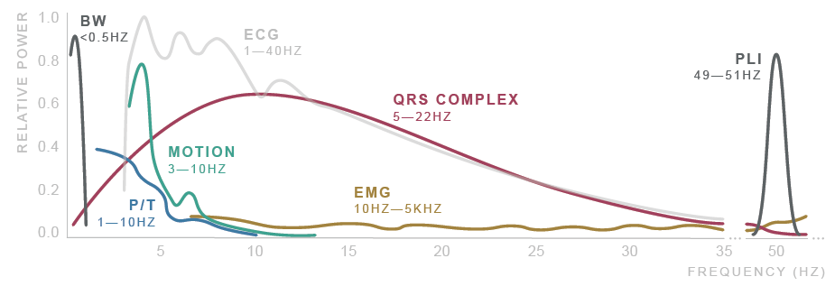
Sources of noise
So far, data are taken as they are, without any type of preprocessing
Is known that ECG requires preprocessing because affected from various sources of noise [2]
Physiological, Environmental, Artifacts and Electronic
There are many strategies used to clean ECG signals: [2]
Numerical Filters
Averaging
Wavelet filtering
…
2. Saraiva, João & Plácido da Silva, Hugo & Fred, Ana. (2022). Denoising and Artifact Removal of the Electrocardiogram, Electrodermal Activity and Accelerometery for Continuous Ambulatory Monitoring of Epileptic Seizures with Wearable Devices.

Slide 6
Outline
Why delve into spectral analysis
Expectations on EG spectrum
Processing pipeline to estimate spectrum
Filtering strategy
Spectrum estimation strategy
Results on external data
Conclusions

Slide 7
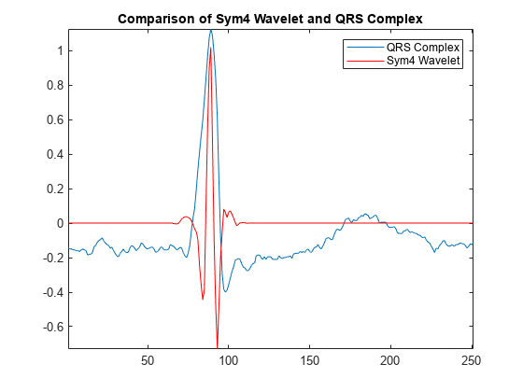
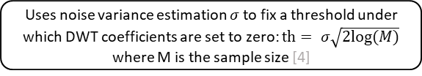
Filtering strategy
Strategy 1: Zero phase band-pass filter [2]
Two Butterworth Zero-Phase filters are used to clean the signal.
Strategy 2: Wavelet thresholding and band-pass filter [2]
Wavelet Soft thresholding to reduce the effect of the high and low frequency noise, improving BP filtering [2,3,4]
BP (zero-phase) filter to remove the residual high frequency noise and remove the possible low-frequency drift [2]
Original signal
Symmetric padding
Improves the overall wavelet transformation but involves a phase shift into the de-padded signal[3]
DWT decomposition
Symlets 4 wavelet is used due to its good performances on ECG signals [2, 3]
Donoho soft thresholding
Uses noise variance estimation $σ$ to fix a threshold under which DWT coefficients are set to zero: $th= σ\sqrt{2log⁡(M)}$ where M is the sample size [4]
De-padding and DWT reconstruction
Butterworth HP filter (order 6, cutoff at 0.5 Hz)
Removes low frequency drift [2]
Butterworth LP filter (order 6, cutoff at 45 Hz)
Removes High frequency noise residuals [2]
3. Singh, Brij N., and Arvind K. Tiwari. "Optimal selection of wavelet basis function applied to ECG signal denoising." Digital signal processing 16.3 (2006): 275-287.
4. Donoho, David L. "De-noising by soft-thresholding." IEEE transactions on information theory 41.3 (1995): 613-627.

Slide 8
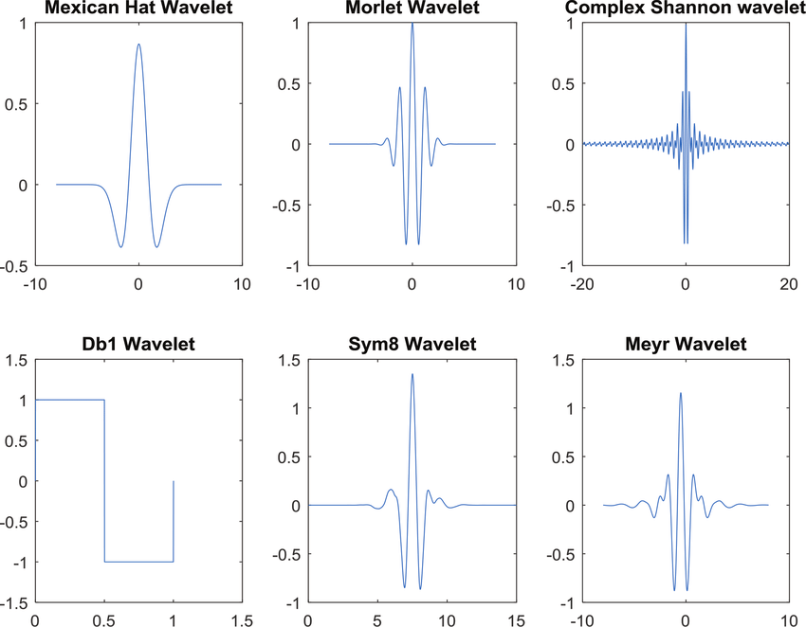

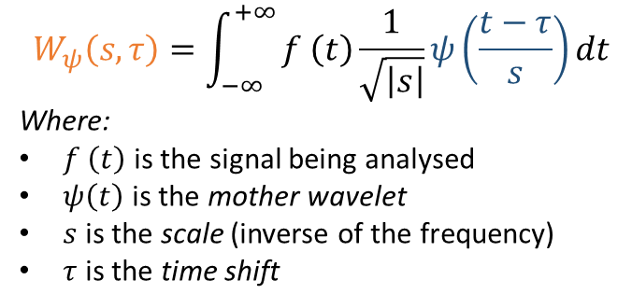
Theory: Continuous Wavelet Transform
The wavelet transform is a technique that allows signal analysis in both the time and frequency domains. Unlike the Fourier transform, which decomposes the signal into sinusoids, the wavelet transform uses "wavelets," localized basis functions.
Mother wavelets are oscillating, localized functions in time, and they are scaled and translated to fit the signal. They must have:
Zero mean
Finite energy
Admissibility condition satisfied: the Fourier Transform of the wavelet must verify $C_{ψ}= \int_{0}^{+∞}{\frac{{\left|\hat{ψ}\left(ω\right)\right|}^{2}}{ω}dω }<∞$ to ensure the inverse of the transform.
Formally, each point (coefficient) of the wavelet transform represent the similarity (dot product) between the signal and the mother wavelet shifted and scaled.
Popular wavelets include Haar, Daubechies, and Morlet, each with distinct properties for different types of signals.
$$W_{ψ}\left(s,τ\right)=\int_{−∞}^{+∞}{f \left(t\right)\frac{1}{\sqrt{\left|s\right|}}ψ\left(\frac{t−τ}{s}\right)dt }$$
Where:
$f \left(t\right)$ is the signal being analysed
$ψ\left(t\right)$ is the mother wavelet
$s$ is the scale (inverse of the frequency)
$τ$ is the time shift

Slide 9
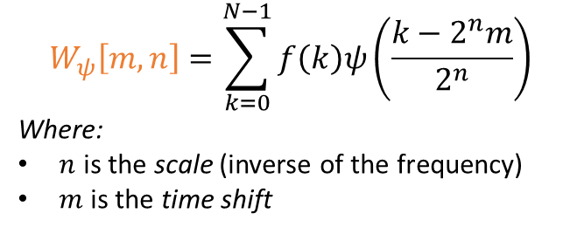
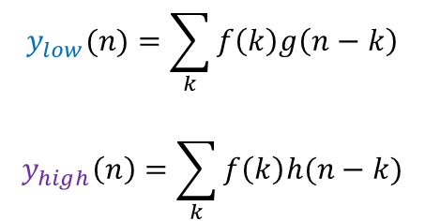
Theory: Discrete Wavelet Transform
The DWT is obtained by discretely sampling the continuous wavelet transform, typically using powers of two for scaling and translation.
The discrete wavelet transform can be implemented using low-pass and high-pass filters followed by under sampling, leading to the so-called filter-bank representation.
This decomposition, for each decomposition level, separates the signal into:
low-frequency components (approximations) through a low pass filter
LP filter derive from the so-called scaling function, which is defined differently for each wavelet type.
high-frequency components (details) through a high pass filter
HP filter derives directly from the mother wavelet.
$$W_{ψ}\left[m,n\right]=\sum_{k=0}^{N−1}{f\left(k\right)ψ\left(\frac{k−2^{n}m}{2^{n}}\right)}$$
Where:
$n$ is the scale (inverse of the frequency)
$m$ is the time shift
$$y_{low}(n)=\sum_{k}{f\left(k\right)g\left(n−k\right)}$$
$$y_{high}\left(n\right)=\sum_{k}{f\left(k\right)h(n−k)}$$

Slide 10
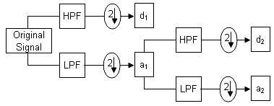
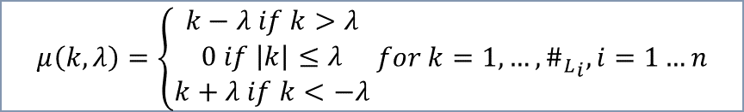
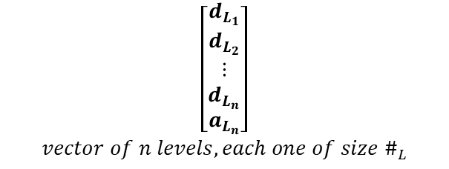
Filtering strategy: wavelet filters
The DWT decomposes a signal into multiple scales, also called levels. At each level it captures both the approximate and detailed components of the signal [3] :
Approximation (LPF) coefficients represent the signal at a coarser resolution (low-frequency content).
Detail coefficients (HPF) represent the finer details (high-frequency content).
The primary idea is that noise predominantly affects the high-frequency components. By thresholding the detail coefficients, one can effectively reduce the noise while preserving the signal.
Soft thresholding [4] (introduced by Donoho) not only sets small coefficients to zero but also shrinks larger coefficients toward zero by the threshold value, smoothing the signal.
$$\left[\begin{aligned}d_{L_{1}} \\ d_{L_{2}} \\ ⋮ \\ d_{L_{n}} \\ a_{L_{n}}\end{aligned}\right]$$
$$vector of n levels, each one of size \#_{L}$$
$$μ\left(k, λ\right)=\left\{\begin{aligned}k−λ if k>λ \\ 0 if \left|k\right|≤λ \\ k+λ if k<−λ\end{aligned} for k=1,…, {\#_{L}}_{i}, i=1…n\right.$$

Slide 11
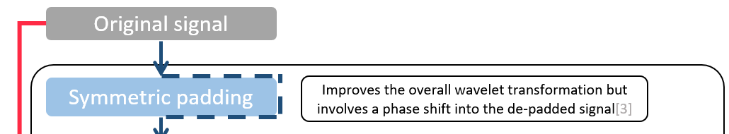
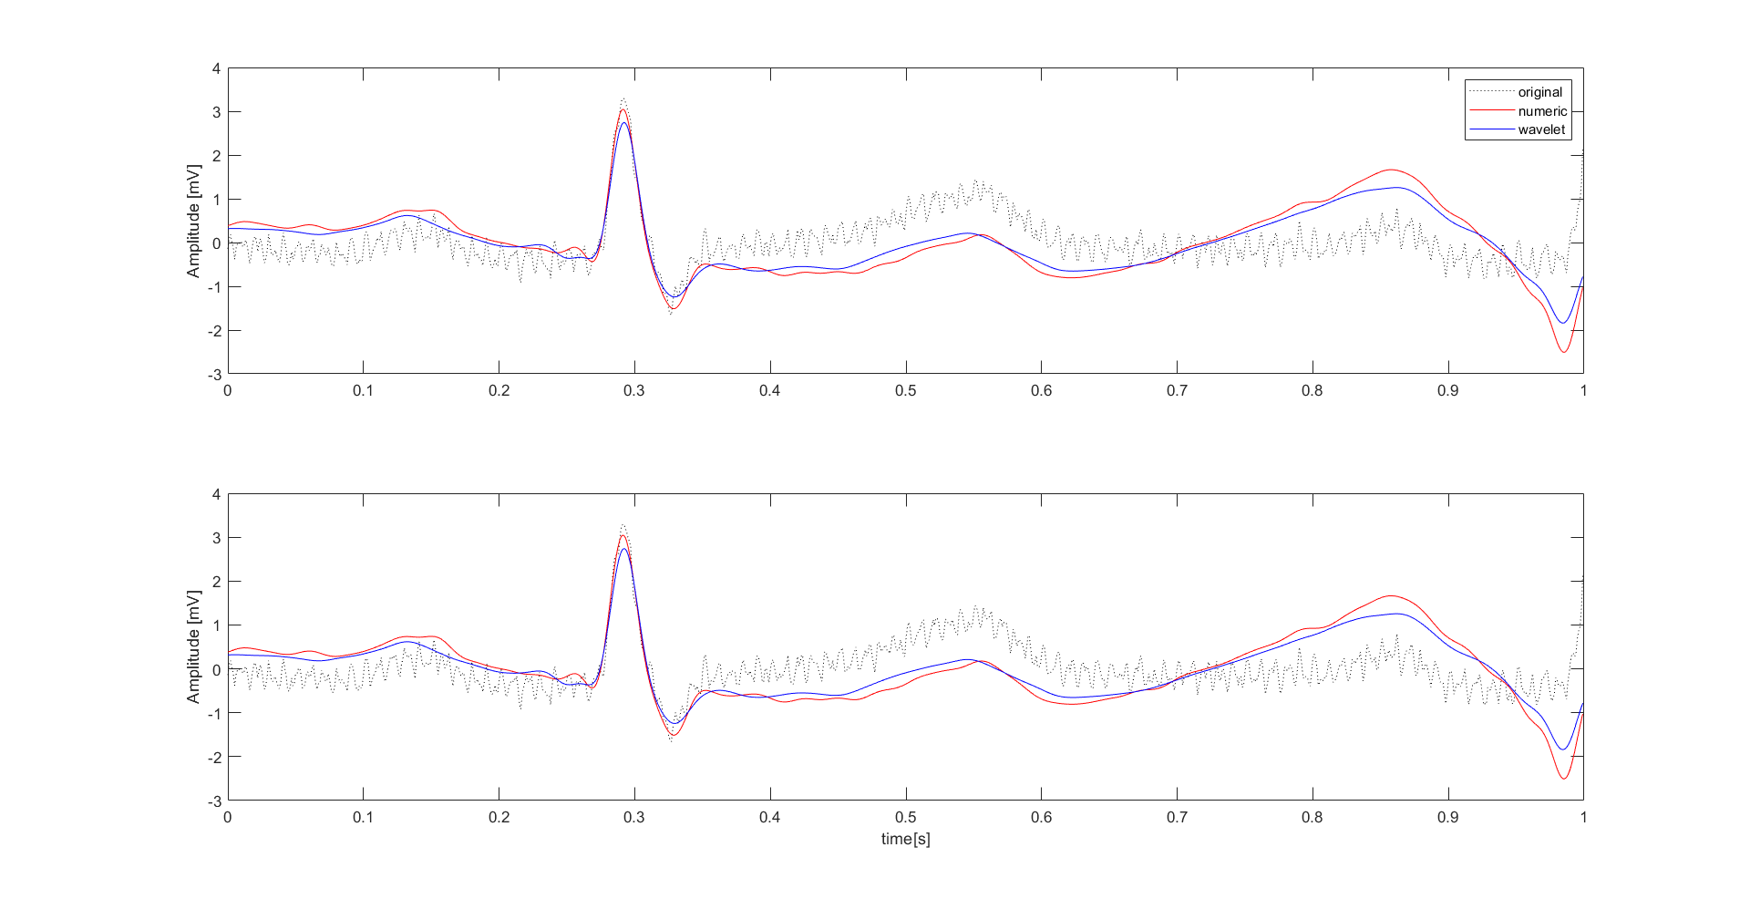
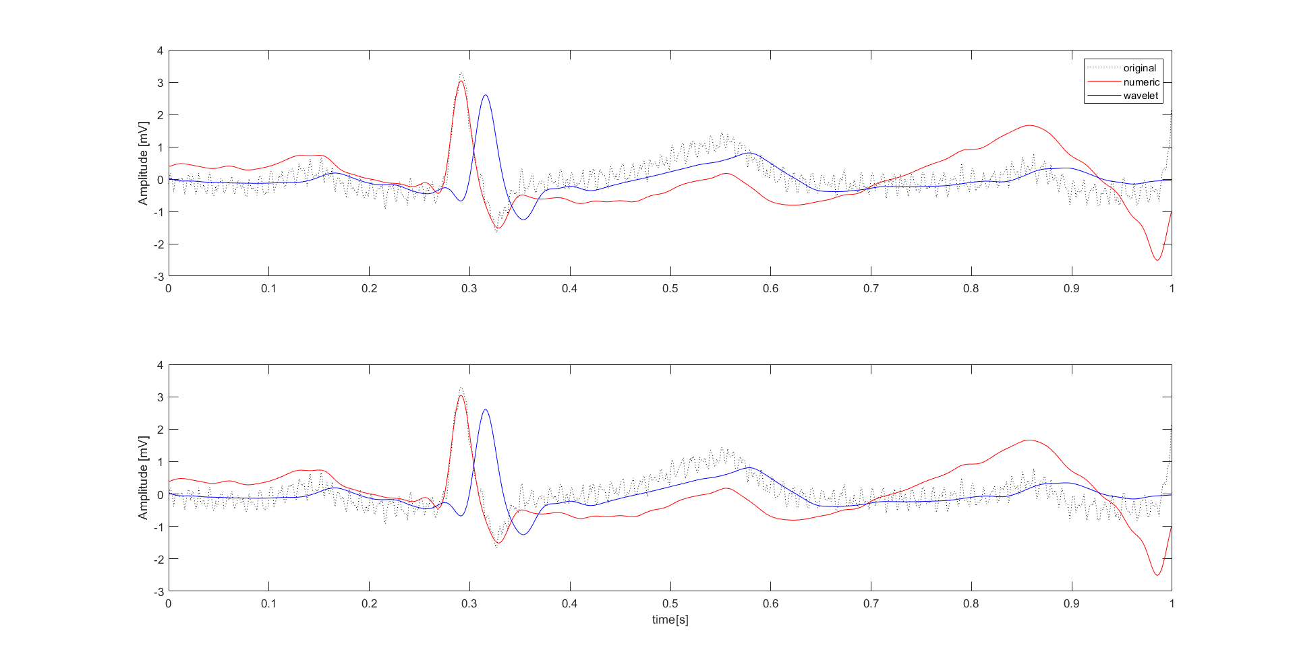
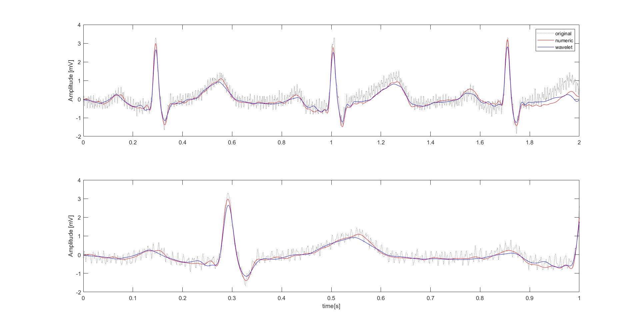
Filtering strategy: padding
To improve the DWT, specially when the number of points of the signal is low (i.e., single beat) ,padding is often used [2]:
Zero padding
Symmetric padding
Circular padding
…
Among all possibilities, it seems that symmetric padding performs better [2,3]. So, in the proposed filtering strategy there is the possibility of using such type of padding.
When padding is present:
Single-beat filtering performance improved
The denoised signal is shifted respect to the original
When padding is absent:
Phase shift is absent
Presence of artifacts into the denoised signal
It should be noted that, when the number of points increases, the padding is not required. So, from now on, it will not be used.
Padding ON, 1000 points, HF noise
Padding OFF, 1000 points, HF noise
Padding OFF, 2000 points, HF noise

Slide 12
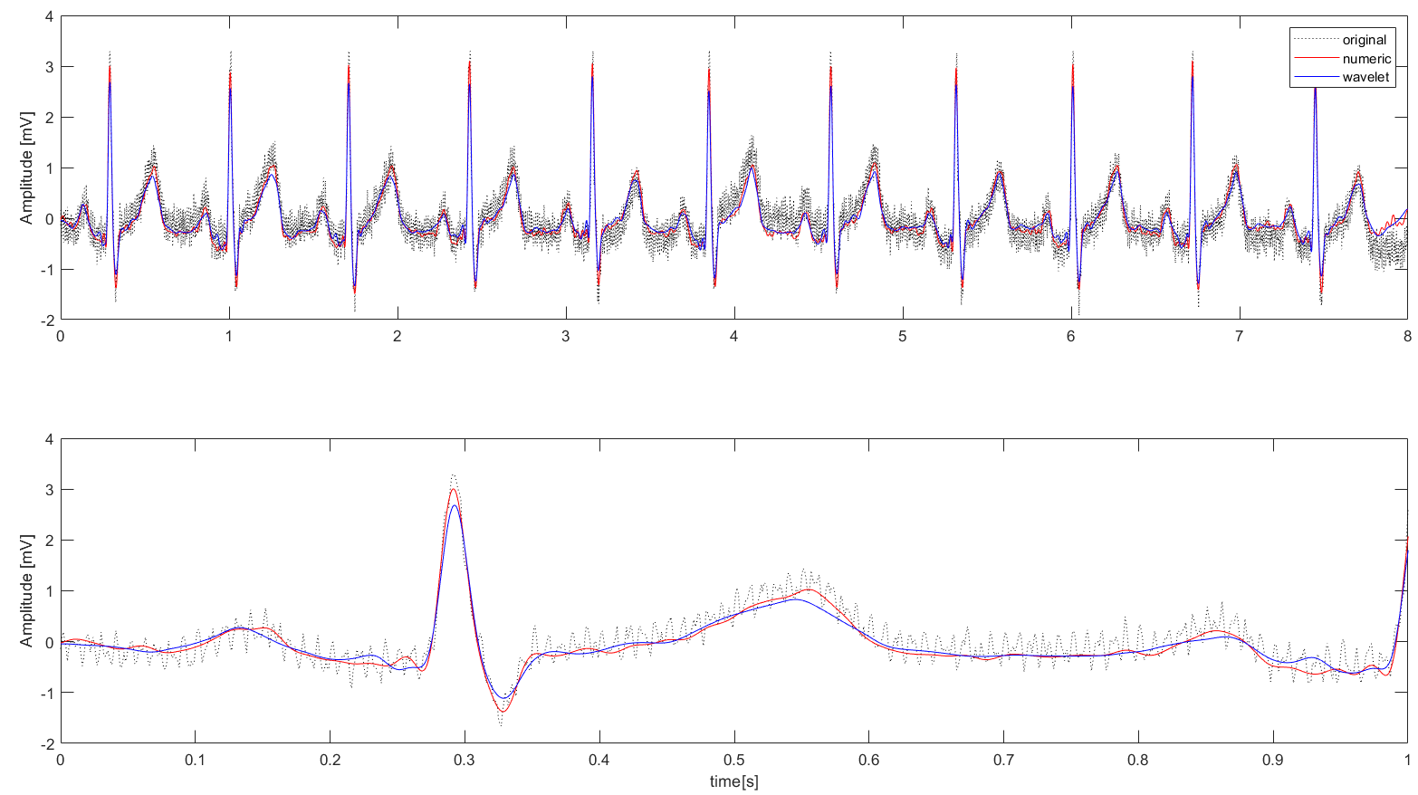
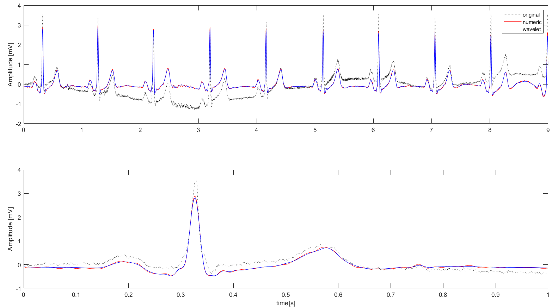
Filtering strategy 1 or 2?
The higher is the level of cleanliness of the signals, the higher will be the goodness of the spectrum, so strategy 1 (BP zero phase filters) and strategy 2 (wavelet and BP zero phase filters) are compared in terms of performances on two “didactics” signals corrupted by high and low frequency noise.
High frequency noise
Strategy 2 performs better than strategy 1, even if strategy 1 reaches good results
Low frequency noise
Both strategies seems to perform well, with very low differences between them.
Because of:
Goodness of results on filtering
Known higher performance even on other sources of noise [2]
Good performances on short signals [2,3]
Strategy 2 (Wavelet thresholding and BP zero phase filters) will be used from now on.

Slide 13
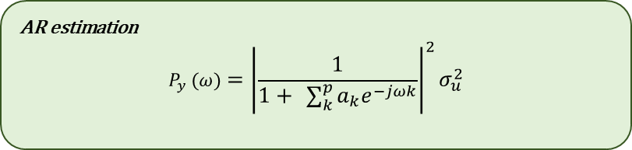
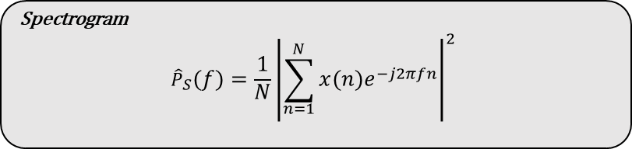

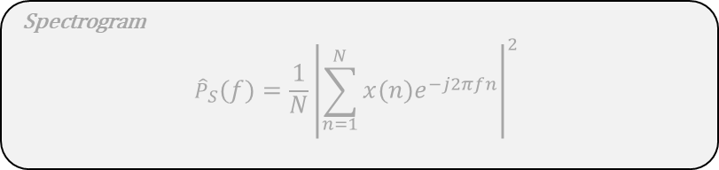
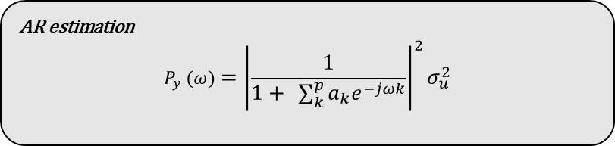

Spectrum estimation
AR estimation
$$P_{y} (ω)={\left|\frac{1}{1+ \sum_{k}^{p}{a_{k}e^{−jωk}}}\right|}^{2}σ_{u}^{2}$$
Spectrum estimation can be done following different strategies:
Parametric strategies: i.e., AR estimation
Non-Parametric Strategies: i.e., Spectrogram or Welch estimation
Here the AR estimation is used due to his many advantages, exposed in the next slide.
AR estimation
$$P_{y} (ω)={\left|\frac{1}{1+ \sum_{k}^{p}{a_{k}e^{−jωk}}}\right|}^{2}σ_{u}^{2}$$
Spectrogram
$${\hat{P}}_{S}\left(f\right)=\frac{1}{N}{\left|\sum_{n=1}^{N}{x\left(n\right)e^{−j2πfn}}\right|}^{2}$$
Spectrogram
$${\hat{P}}_{S}\left(f\right)=\frac{1}{N}{\left|\sum_{n=1}^{N}{x\left(n\right)e^{−j2πfn}}\right|}^{2}$$
Welch Spectrogram
$${\hat{P}}_{W}\left(f\right)=\frac{1}{S}\sum_{l=1}^{S}{{\hat{P}}_{l}(f)} and {\hat{P}}_{l}\left(f\right)=\frac{1}{P}\frac{1}{M}{\left|\sum_{n=1}^{M}{v\left(n\right)x_{l}\left(n\right)e^{−j2πfn}}\right|}^{2}$$
Where:
$v\left(n\right)$ is a window of size M
P is the average of the window $v\left(n\right)$, defined as $P=\frac{1}{M}{\sum_{i}^{M}{\left|v\left(n\right)\right|}}^{2}$
Windows divide the signals in S, partially overlapping, segments
Welch Spectrogram
$${\hat{P}}_{W}\left(f\right)=\frac{1}{S}\sum_{l=1}^{S}{{\hat{P}}_{l}(f)} and {\hat{P}}_{l}\left(f\right)=\frac{1}{P}\frac{1}{M}{\left|\sum_{n=1}^{M}{v\left(n\right)x_{l}\left(n\right)e^{−j2πfn}}\right|}^{2}$$
Where:
$v\left(n\right)$ is a window of size M
P is the average of the window $v\left(n\right)$, defined as $P=\frac{1}{M}{\sum_{i}^{M}{\left|v\left(n\right)\right|}}^{2}$
Windows divide the signals in S, partially overlapping, segments

Slide 14
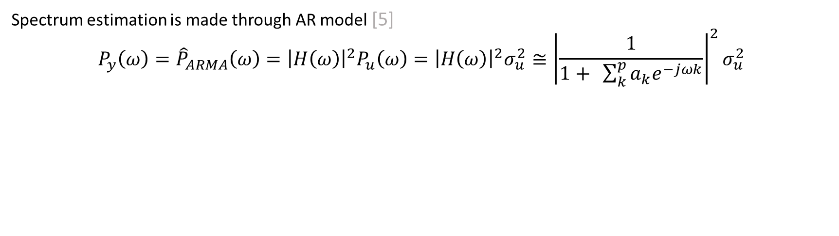
Spectrum estimation
Spectrum estimation is made through AR model [5]
$${P_{y}\left(ω\right)=\hat{P}}_{ARMA}\left(ω\right)={\left|H\left(ω\right)\right|}^{2}P_{u}\left(ω\right)={\left|H\left(ω\right)\right|}^{2}σ_{u}^{2}≅{\left|\frac{1}{1+ \sum_{k}^{p}{a_{k}e^{−jωk}}}\right|}^{2}σ_{u}^{2}$$
Spectrum of the target signal
Spectrum of ARMA model
Spectrum of the input signal of the model (white noise)
Transfer function of the AR model which approximates the ARMA one
ARMA models can be approximated by an AR with sufficiently high order
Fast and easy application
Require a zero-mean signal as input of the estimator of the model
Consistent and not windowed estimation of the spectrum
Order choice is crucial

Slide 15
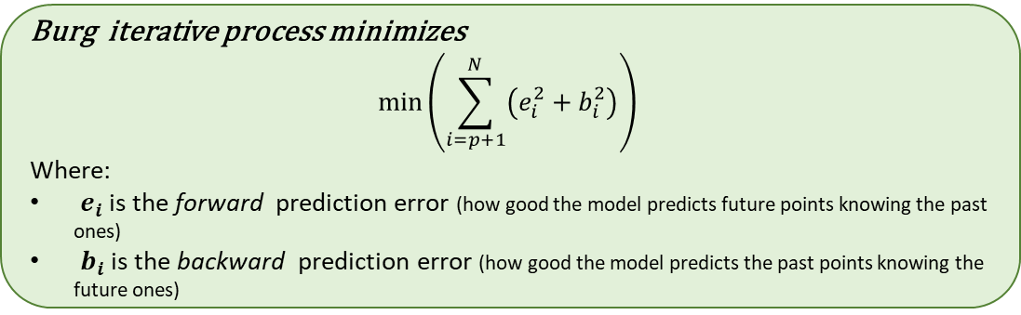
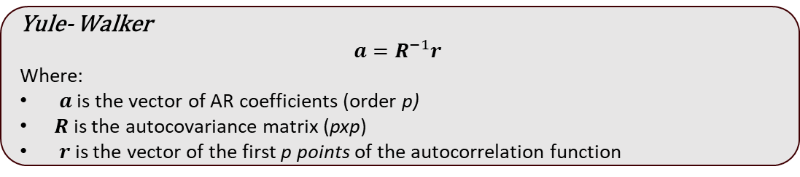
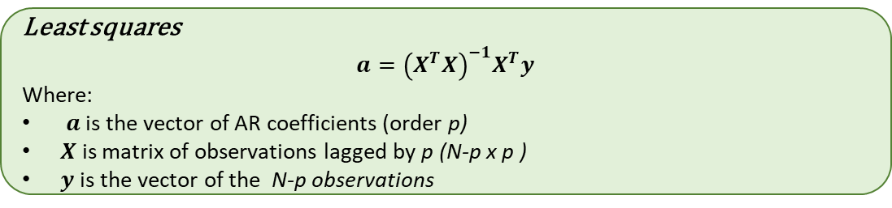
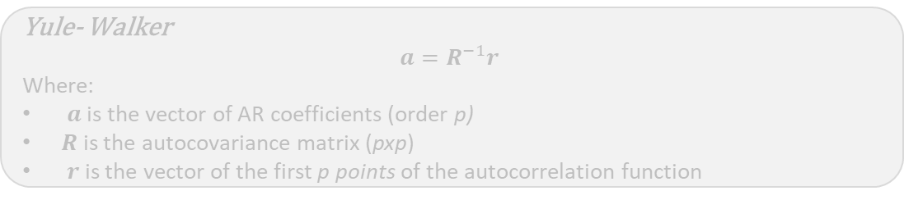
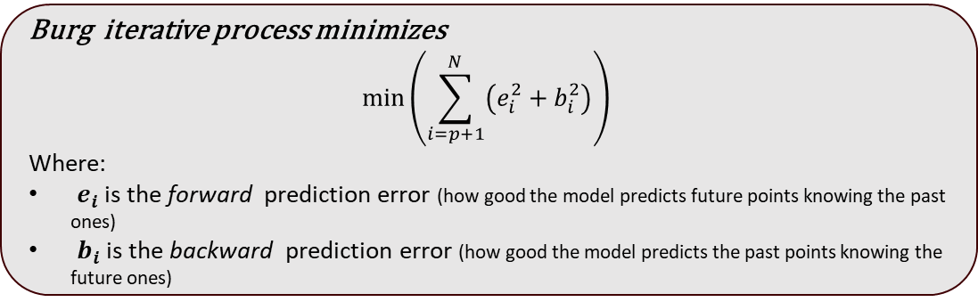
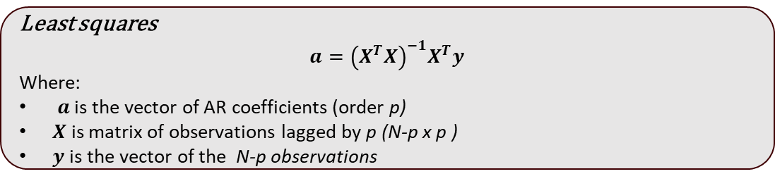
Spectrum estimation: AR identification
Yule- Walker
$$a=R^{−1}r$$
Where:
$a$ is the vector of AR coefficients (order p)
$R$ is the autocovariance matrix (pxp)
$r$is the vector of the first p points of the autocorrelation function
When dealing with AR models, and in particular if used to evaluate spectrums, the estimation method must be chosen carefully. From previous studies [5,6] is known that:
Yule-Walker estimation:
Ensure stable models
Requires high order models and does not have good frequency resolution
Least-Squares estimation:
Does not ensure stable models (but it’s not a problem if the order is low)
Have high frequency resolution and performs well with lower orders
Burg’s estimation:
Ensure stable models
Ensure high frequency resolution
NB: the difference is mainly on the value (and number) of the coefficients, while the spectrum estimation formula remains the same.
Yule- Walker
$$a=R^{−1}r$$
Where:
$a$ is the vector of AR coefficients (order p)
$R$ is the autocovariance matrix (pxp)
$r$is the vector of the first p points of the autocorrelation function
Least squares
$$a={\left(X^{T}X\right)}^{−1}X^{T}y$$
Where:
$a$ is the vector of AR coefficients (order p)
$X$ is matrix of observations lagged by p (N-p x p )
$y$is the vector of the N-p observations
Least squares
$$a={\left(X^{T}X\right)}^{−1}X^{T}y$$
Where:
$a$ is the vector of AR coefficients (order p)
$X$ is matrix of observations lagged by p (N-p x p )
$y$is the vector of the N-p observations
Burg iterative process minimizes
$$\min\left(\sum_{i=p+1}^{N}{\left(e_{i}^{2}+b_{i}^{2}\right)}\right)$$
Where:
$e_{i}$ is the forward prediction error (how good the model predicts future points knowing the past ones)
$b_{i}$ is the backward prediction error (how good the model predicts the past points knowing the future ones)
Burg iterative process minimizes
$$\min\left(\sum_{i=p+1}^{N}{\left(e_{i}^{2}+b_{i}^{2}\right)}\right)$$
Where:
$e_{i}$ is the forward prediction error (how good the model predicts future points knowing the past ones)
$b_{i}$ is the backward prediction error (how good the model predicts the past points knowing the future ones)
5. Übeyli, Elif Derya, Dean Cvetkovic, and Irena Cosic. "AR spectral analysis technique for human PPG, ECG and EEG signals." Journal of Medical Systems 32 (2008): 201-206.
6. Nayak, Jagadish, et al. "AR modeling of heart rate signals." 2004 IEEE Region 10 Conference TENCON 2004.. IEEE, 2004.

Slide 16
Spectrum estimation: AR order choice
AR spectrum estimation is a well-established strategy but requires to fix the order of the model [5]
There are many strategies [6]:
AIC criterion
BIC criterion
AIC/BIC mixed strategy
Similarity between AR spectrum estimation and classical/Welch spectrogram
But there isn’t a “fixed” rule. In other studies, the optimal order is found to be between 8 and 20 (Burg and LS estimations) [5,6] and all cases was fixed.
Normalized AIC criterium has been used on a range of candidate orders, with a threshold to decide whether the order reached improves significantly the estimation.
p_opt = evaluate_order(signal, min_order, max_order, step, eps, type)
Initialize AIC_vector to store AIC values for each model order
Initialize AIC_difference as an empty array
Initialize p_opt (optimal order) to 0
Loop through each model order in the range of p (min_order:step:max_order):
Fit AR model to the signal (after removing the mean), using the type estimation, for the current order p(i)
Calculate the AIC for the current AR model and store it in AIC_vector[i]
If this is not the first iteration (i > 1):
Compute the absolute difference between the current AIC and the previous AIC and store it in AIC_difference
If the AIC difference is less than a tolerance value (eps):
Break the loop (convergence achieved)
Find the position of the optimal order where AIC_difference is less than epsilon
If no convergence was found (position not found):
Set the optimal position to the index of the minimum AIC value in AIC_vector
Set p_opt (optimal order) to the value of p at the optimal position

Slide 17
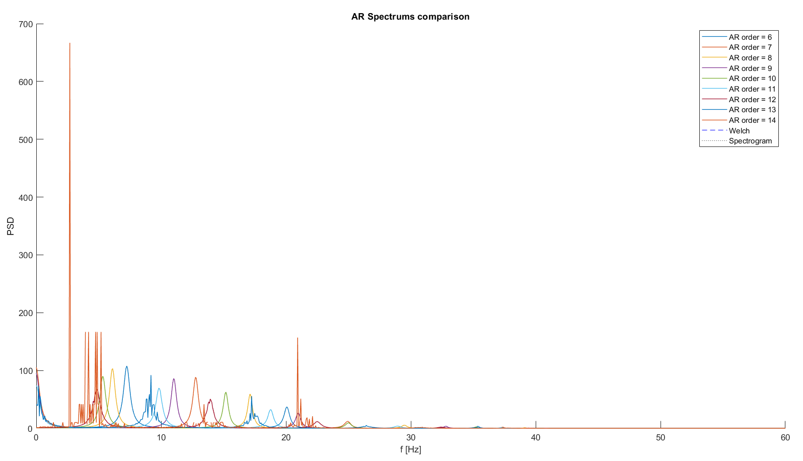
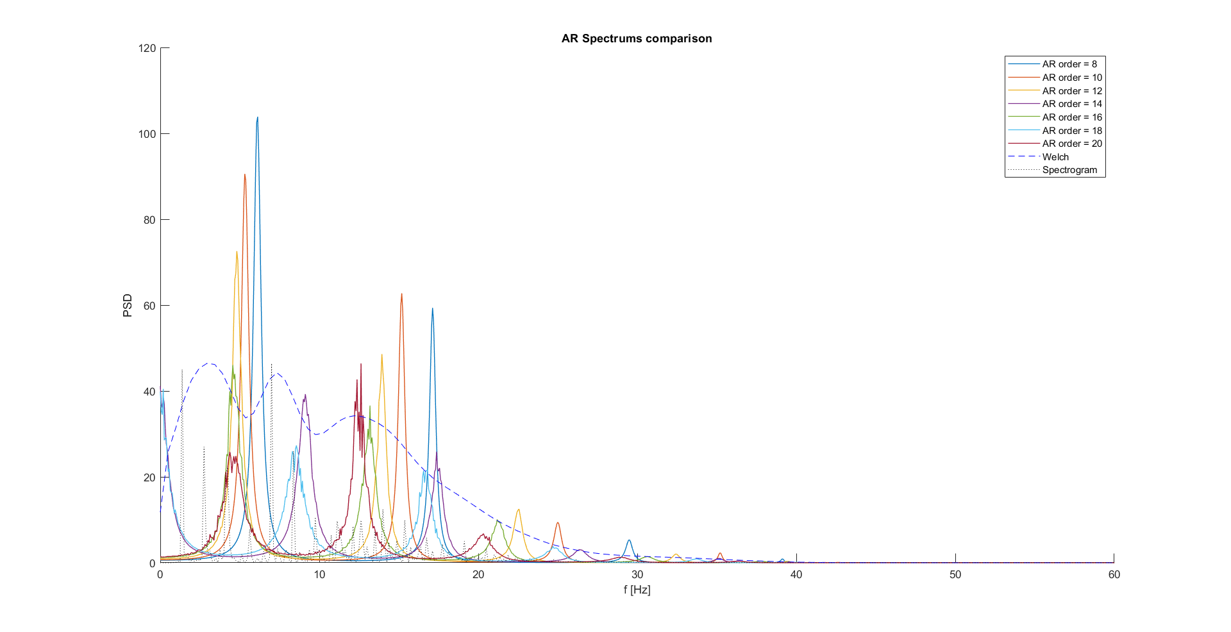
Spectrum estimation: orders boundaries
It’s important decide the range into which found the optimal order.
From literature, an order between 8 and 20 should be enough for LS or Burg estimators. [5,6]
Order choice is computationally demanding
Burg estimation
LS estimation
LS estimation seems to be more robust on high orders
Both tent to be more affected by noise when the order increases (>18)
Optimal order was searched between 8 and 16 at the end

Slide 18
Outline
Why delve into spectral analysis
Expectations on EG spectrum
Processing pipeline to estimate spectrum
Filtering strategy
Spectrum estimation strategy
Results on external data
Conclusions

Slide 19
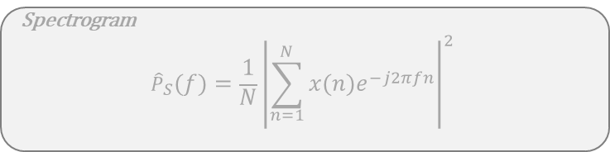
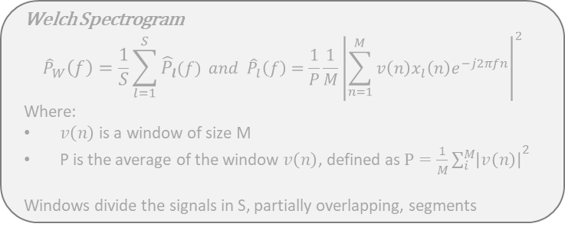
Spectrum estimation: AR order choice
Before applying the algorithm to the AVNRT data, it has been tested on external data:
Didactical ECG with High Frequency noise (Fc: 1000 Hz, ~ 8500 points)
Didactical ECG with Low Frequency noise (Fc: 1000 Hz, ~ 9000 points)
PhysioNet Database ECG data: healthy and pathological (Fc: 360 Hz, 9000 points)
For all these scenarios have been plotted the AR spectrums compared with the Welch spectrum and the FFT periodogram
The number of points onto evaluating the spectrums are increased to see the behaviour of the analysis when considering an increasing number of cardiac beats
Spectrogram
$${\hat{P}}_{S}\left(f\right)=\frac{1}{N}{\left|\sum_{n=1}^{N}{x\left(n\right)e^{−j2πfn}}\right|}^{2}$$
Welch Spectrogram
$${\hat{P}}_{W}\left(f\right)=\frac{1}{S}\sum_{l=1}^{S}{{\hat{P}}_{l}(f)} and {\hat{P}}_{l}\left(f\right)=\frac{1}{P}\frac{1}{M}{\left|\sum_{n=1}^{M}{v\left(n\right)x_{l}\left(n\right)e^{−j2πfn}}\right|}^{2}$$
Where:
$v\left(n\right)$ is a window of size M
P is the average of the window $v\left(n\right)$, defined as $P=\frac{1}{M}{\sum_{i}^{M}{\left|v\left(n\right)\right|}}^{2}$
Windows divide the signals in S, partially overlapping, segments

Slide 20
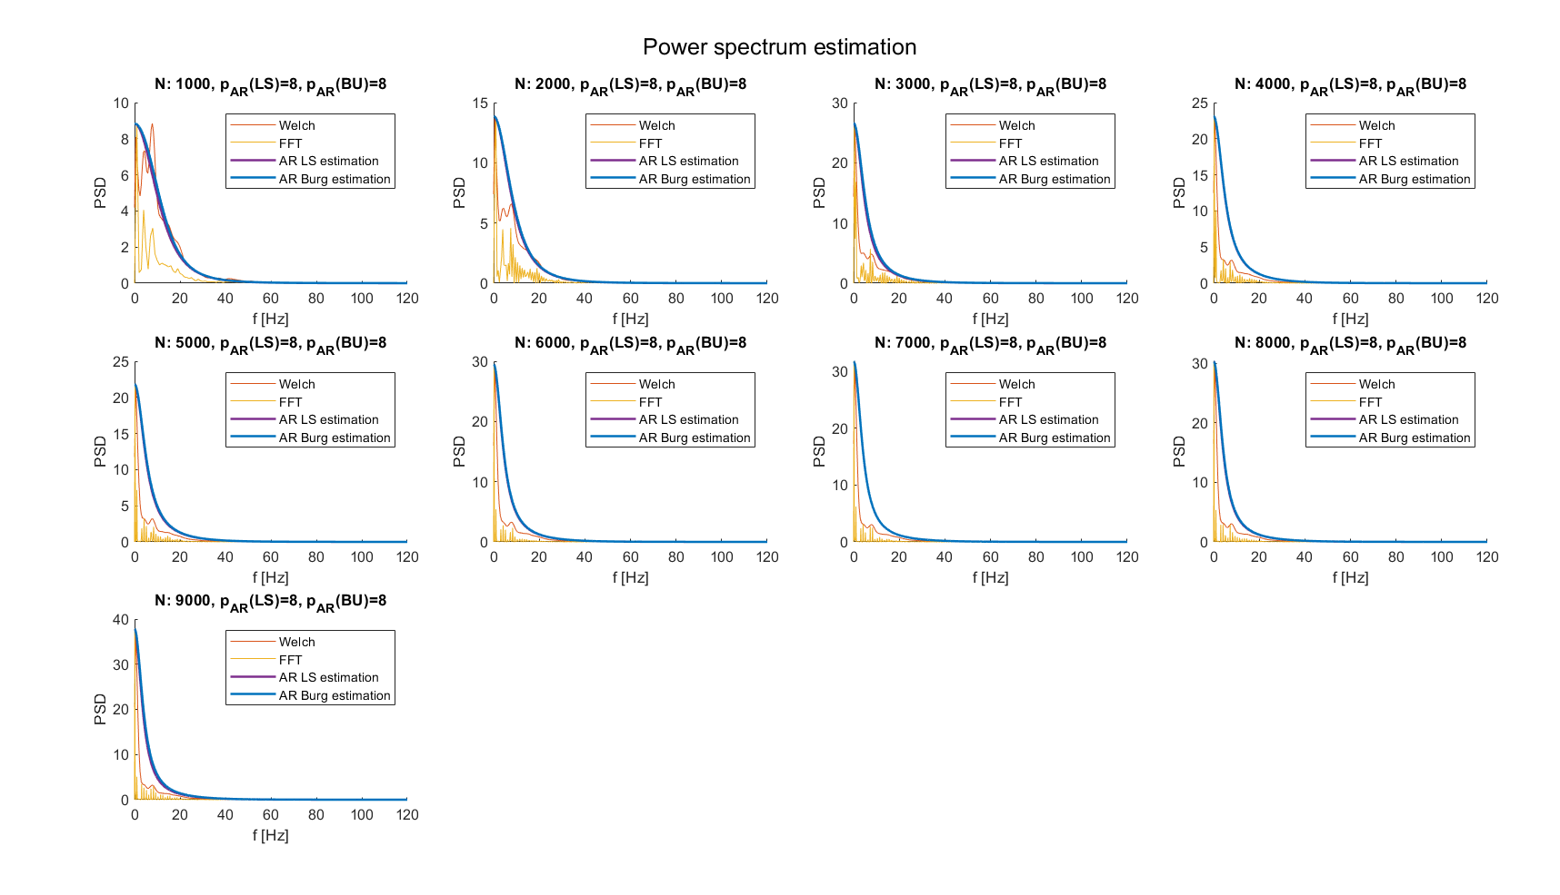
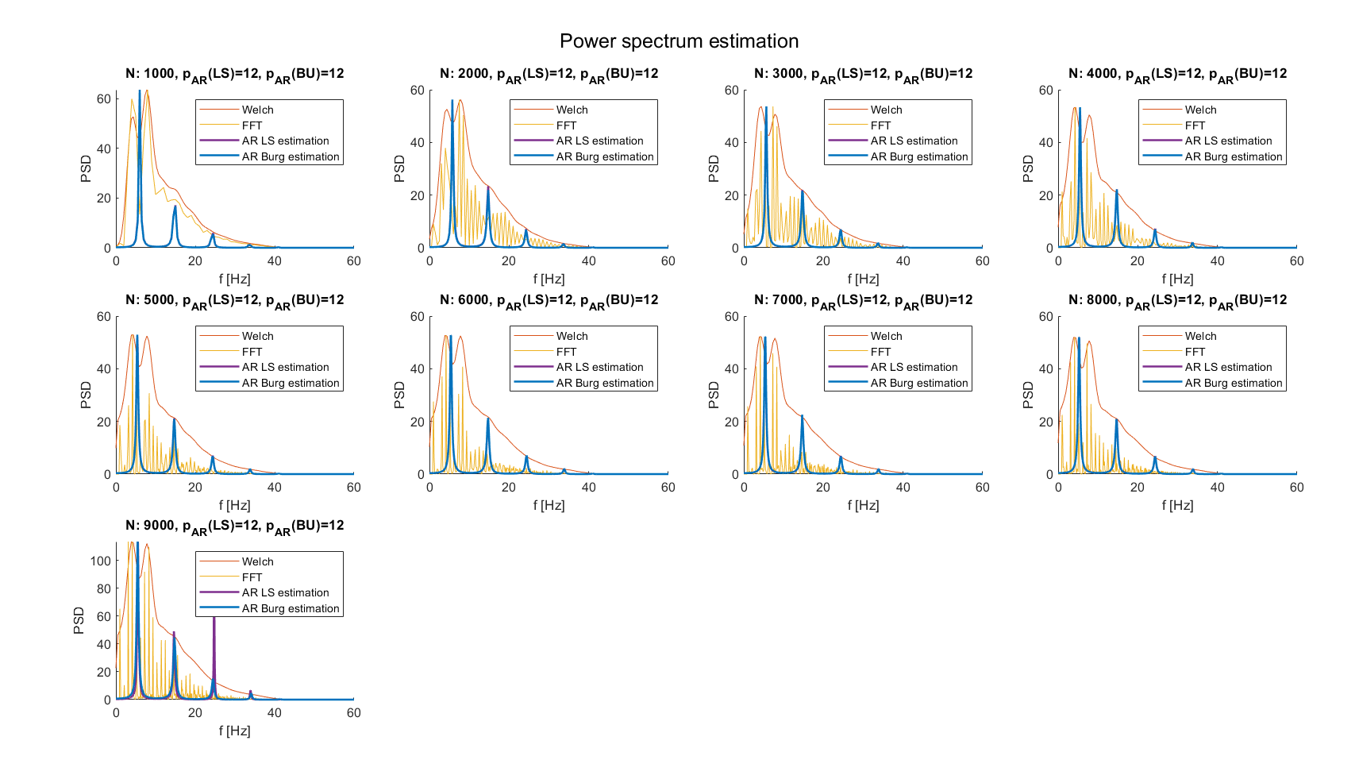
Spectrum before and after filter
Low frequency noise record
Spectrum estimation is clearly affected by noise
Shape not useful and not informative
Filtered Record
Frequency resolution clearly improved after filtering
Good estimation of non-parametric spectrums

Slide 21
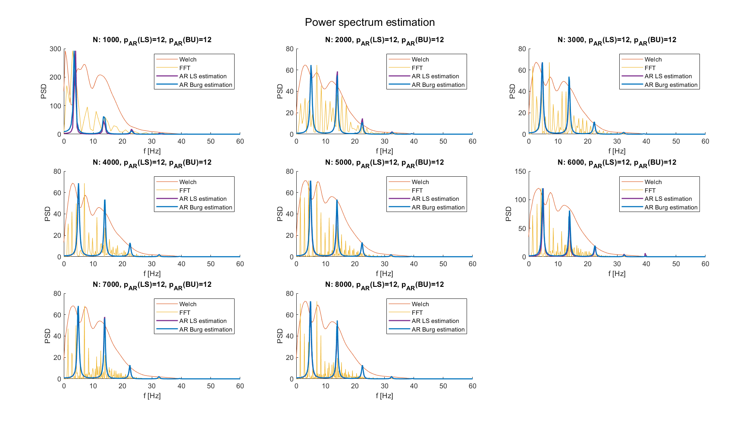
Spectrum of didactical examples
As the used ECG signals are obtained by adding noise a posterior, once cleaned they should correspond to the same spectrum estimation.
HF noise filtered record
LF noise filtered Record

Slide 22
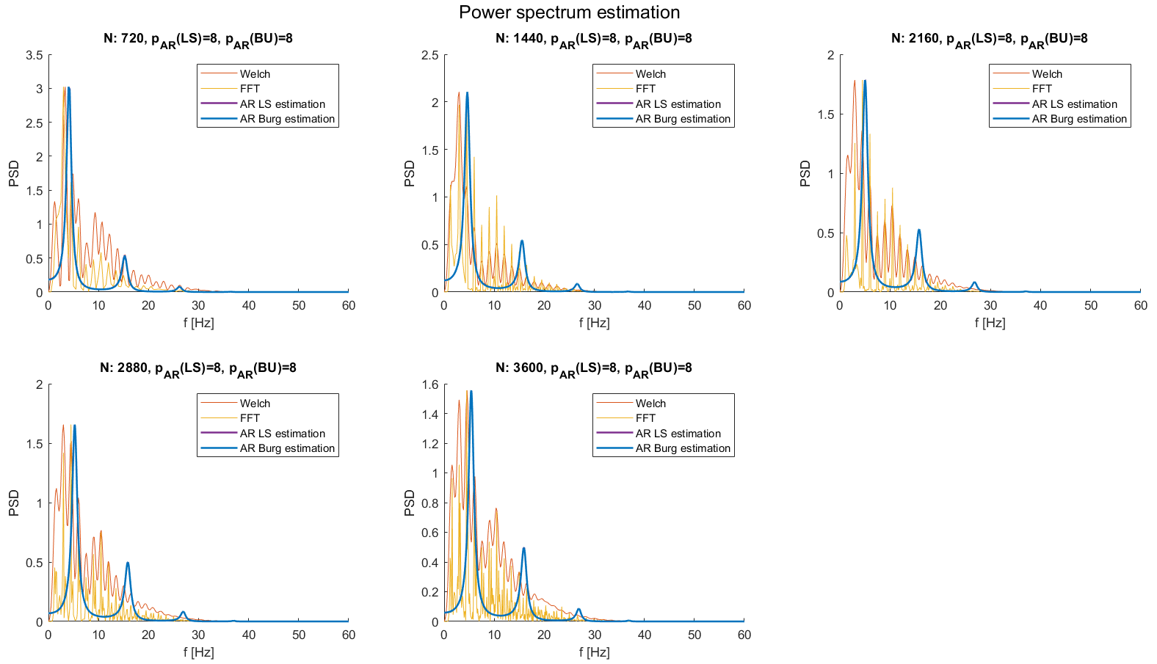
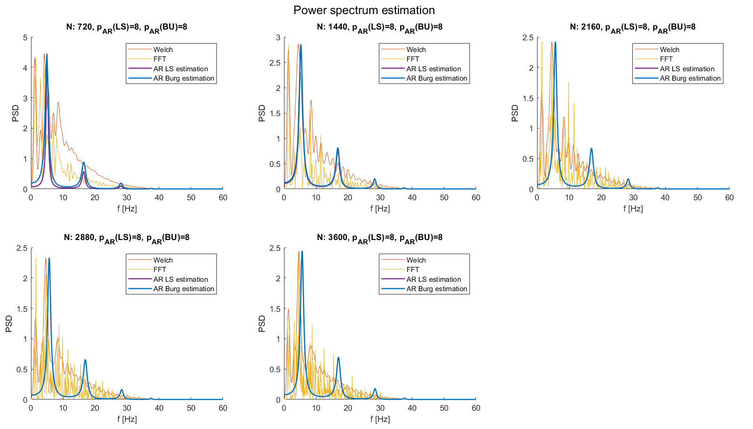
PhysioNet database
Healthy record
Good estimation of Welch spectrum even on “real world” data
Peaks presence limited between 0 and 30 Hz
Pathological Record
Good estimation of Welch spectrum
Presence of peaks above 30 Hz, an aspect that can be traced back to the pathology

Slide 23
Outline
Why delve into spectral analysis
Expectations on EG spectrum
Processing pipeline to estimate spectrum
Filtering strategy
Spectrum estimation strategy
Results on external data
Conclusions

Slide 24
Conclusions
This presentation shows a method for estimating the spectrum of an ECG signal. In particular:
A mixed filtering strategy, with wavelet thresholding and numerical filter, is used with good performances. Filtering pipeline could include padding, which improves performances on short-length signals but leads to a phase shift.
AR optimal order was found between 8 and 16, while using nAIC as metric.
Least Squares and Burg’s estimation approaches are both used for their high frequency resolution. When augmenting the number of points, provides the same spectrum estimation.
Overall performances of the method are satisfying. In particular, the differences between the spectra of healthy and pathological ECG signals can be seen

Slide 25
References
Sörnmo, Leif, and Pablo Laguna. "Electrocardiogram (ECG) signal processing." Wiley encyclopaedia of biomedical engineering (2006).
Saraiva, João & Plácido da Silva, Hugo & Fred, Ana. (2022). Denoising and Artifact Removal of the Electrocardiogram, Electrodermal Activity and Accelerometery for Continuous Ambulatory Monitoring of Epileptic Seizures with Wearable Devices. 10.13140/RG.2.2.10053.12004.
Singh, Brij N., and Arvind K. Tiwari. "Optimal selection of wavelet basis function applied to ECG signal denoising." Digital signal processing 16.3 (2006): 275-287.
Donoho, David L. "De-noising by soft-thresholding." IEEE transactions on information theory 41.3 (1995): 613-627.
Übeyli, Elif Derya, Dean Cvetkovic, and Irena Cosic. "AR spectral analysis technique for human PPG, ECG and EEG signals." Journal of Medical Systems 32 (2008): 201-206.
Nayak, Jagadish, et al. "AR modeling of heart rate signals." 2004 IEEE Region 10 Conference TENCON 2004.. IEEE, 2004.

